Slide 1
TITLE: Analysis of Amazon Sales Data
Impact of Discounts on Product Ratings and Prices
AMRUTHA VARSHINI MAVURI
7th Nov, 2024

Slide 2
PROBLEM STATEMENT
Amazon, as a leading e-commerce platform, offers a huge amount of products at varying price points and discount levels. Understanding the impact of discounts on product ratings and sales is crucial for optimizing pricing strategies and improving customer satisfaction. This analysis aims to explore the relationship between discount percentage, product price, and customer ratings to uncover valuable insights for both consumers and businesses
REASEARCH QUESTION:
What are the key factors that contribute to product popularity on Amazon, and how do these factors interact with each other?
DATA SOURCE : Amazon sales data from KAGGLE

Slide 3
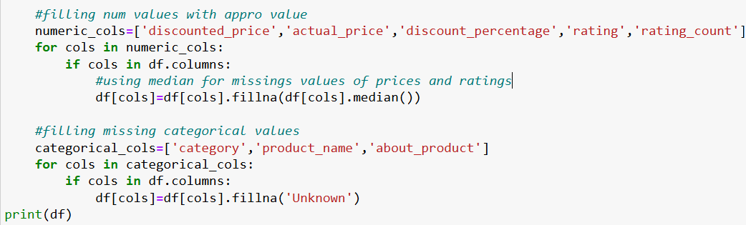
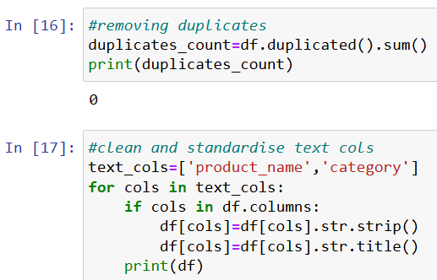
DATA CLEANING AND PREPARATION
Data was cleaned and prepared to make it accurate for analysis.
Data cleaning and Preparation process involved fixing missing values, removing outliers, and duplicates.
Data preparation involved Cleaning and standardizing data in the columns.

Slide 4
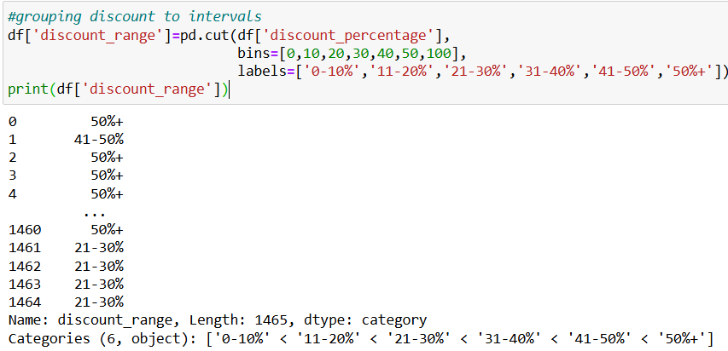
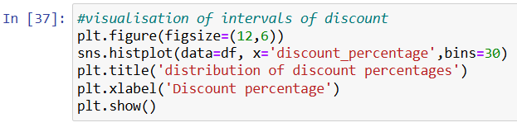
EXPLORATORY DATA ANALYSIS
Performed Statistical Analysis such as mean, median, standard deviation, finding and filling the null values for relevant variables.

Slide 5
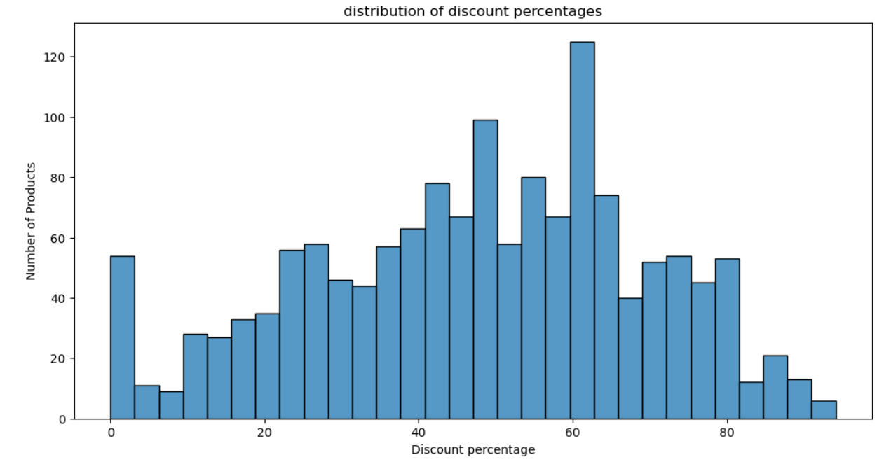
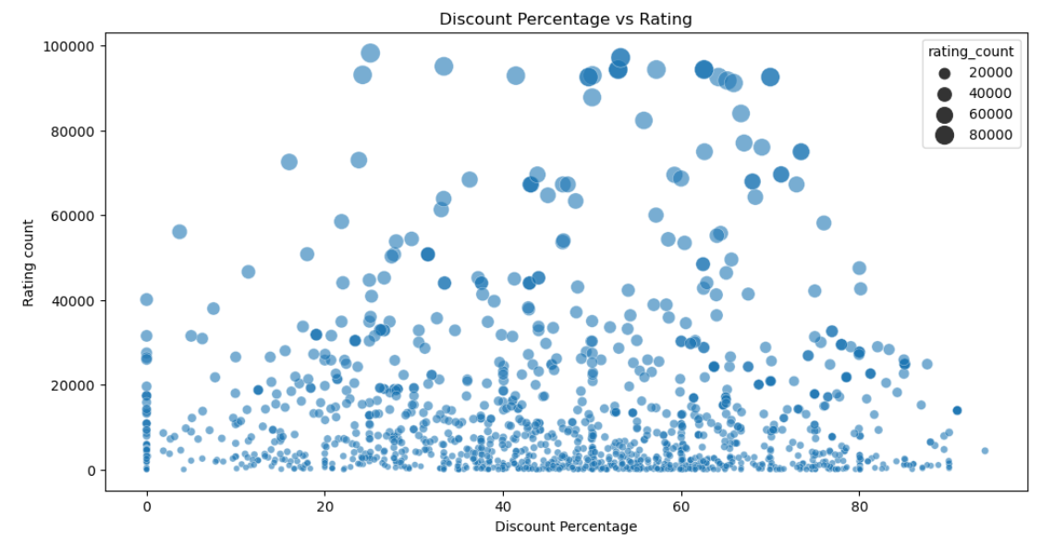
VISUALIZATION ON EDA
Performed visualization on Distribution of Discount percentage and correlations with prices and Ratings
Histogram
Scatterplot

Slide 6
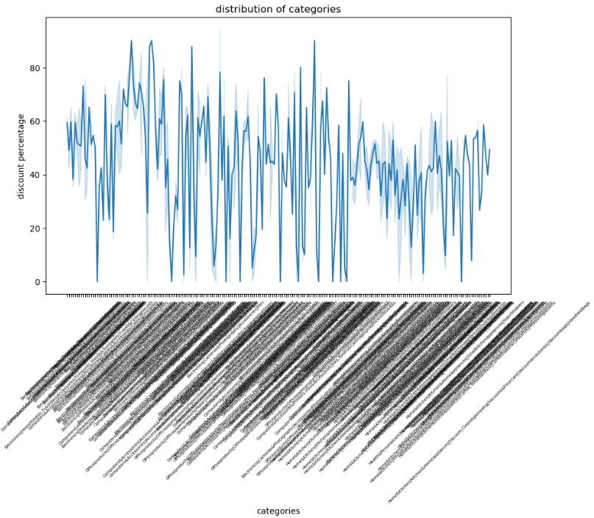
DATA ANALYSIS AND VISUALIZATION
IMPACT OF DISCOUNTS ON PRODUCT CATEGORIES
Key Finding: Discounts have a varying impact on different product categories. Electronics and Books categories are more responsive to discounts, while Clothing and Accessories show a weaker correlation.
Visualization: A bar chart comparing average discount percentages for various product categories.
Interpretation: Businesses can optimize their discounting strategies by targeting specific categories. For instance, offering higher discounts on electronics and books can drive sales and customer satisfaction.

Slide 7
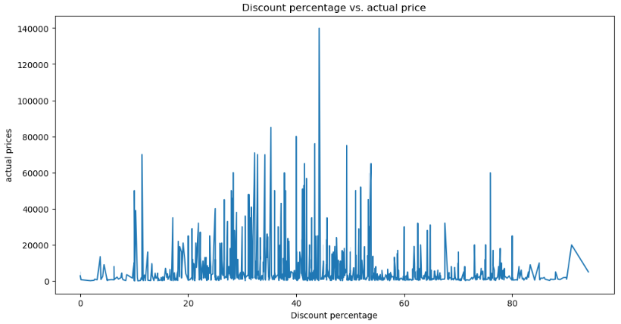
IMPACT OF DISCOUNTS ON ACTUAL PRICE
Key Finding: Higher-priced products tend to receive larger discounts, suggesting a strategy to stimulate demand for premium products.
Visualization: A scatter plot showing a positive correlation between discount percentage and actual price.
Interpretation: Businesses can use targeted discounts to move high-priced products and generate additional revenue. However, it's essential to balance discounts with profit margins and customer perception.

Slide 8
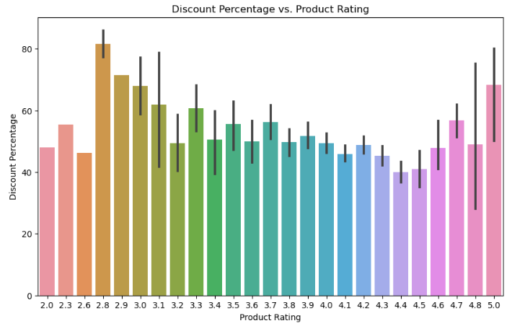
IMPACT OF DISCOUNTS ON PRODUCT RATINGS
Key Finding: Discounts have a complex relationship with product ratings. While moderate discounts can positively influence ratings, excessive discounts may lead to lower ratings.
Visualization: A scatter plot showing a weak negative correlation between discount percentage and product rating, with some outliers.
Interpretation: Businesses should be cautious about offering excessive discounts, as they may negatively impact perceived product quality. A balanced approach, considering factors like brand reputation and product value, is crucial.

Slide 9
THANK YOU

